Slide 1
Tables Homework
Spring 2018

Slide 2
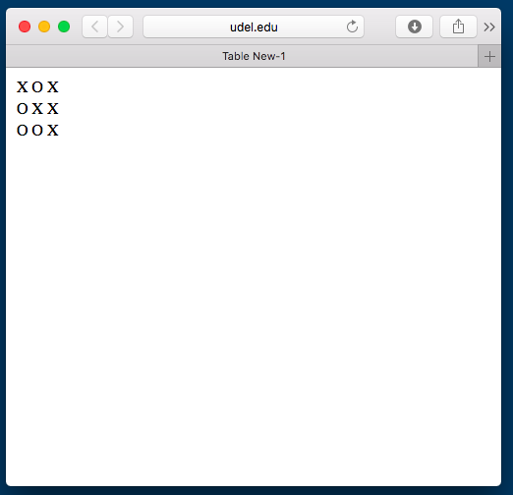
html file
Web
<html> <head> <title>Table 1</title> </head> <body> <table>
<tr> <td align="center">X</td>
<td align="center">O</td>
<td align="center">X</td> </tr>
<tr> <td align="center">O</td>
<td align="center">X</td>
<td align="center">X</td> </tr> <tr> <td align="center">O</td>
<td align="center">O</td>
<td align="center">X</td>
</tr> </table> </body> </html>

Slide 3
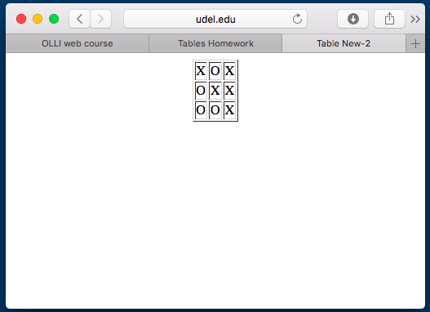
html file
Web
<html>
<head> <title>Table 2</title> </head> <body> <table align="center" border="1”>
<tr> <td align="center">X</td>
<td align="center">O</td>
<td align="center">X</td> </tr> <tr> <td align="center">O</td>
<td align="center">X</td>
<td align="center">X</td> </tr> <tr> <td align="center">O</td>
<td align="center">O</td>
<td align="center">X</td> </tr> </table> </body> </html>

Slide 4
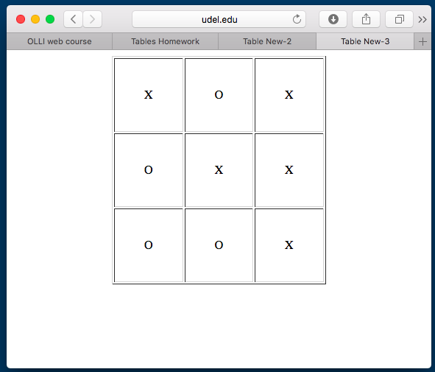
html file
Web
<html>
<head> <title>Table 3</title> </head> <body> <table align="center" border="1"
cellpadding="40”>
<tr> <td align="center">X</td>
<td align="center">O</td>
<td align="center">X</td> </tr> <tr> <td align="center">O</td>
<td align="center">X</td>
<td align="center">X</td> </tr> <tr> <td align="center">O</td>
<td align="center">O</td>
<td align="center">X</td> </tr> </table> </body> </html>

Slide 5
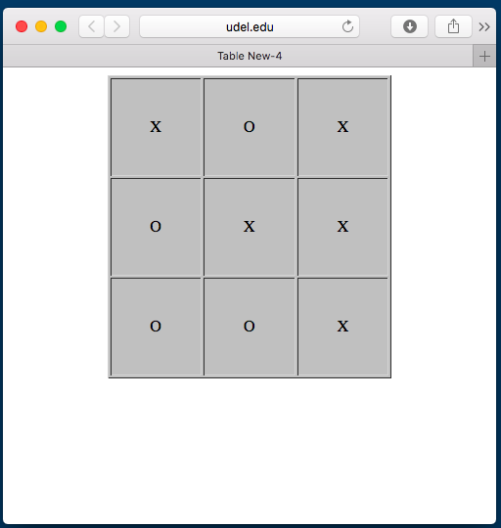
html file
Web
<html>
<head> <title>Table 4</title> </head> <body> <table align="center" border="1"
cellpadding="40" bgcolor="silver">
<tr> <td align="center">X</td>
<td align="center">O</td>
<td align="center">X</td> </tr> <tr> <td align="center">O</td>
<td align="center">X</td>
<td align="center">X</td> </tr> <tr> <td align="center">O</td>
<td align="center">O</td>
<td align="center">X</td> </tr> </table> </body> </html>

Slide 6
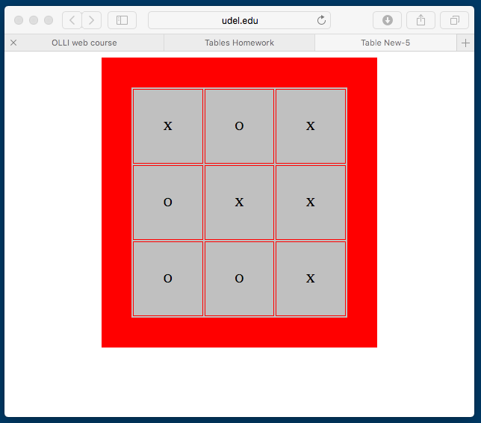
html file
Web
<html> <head> <title>Table 5</title>
</head> <body>
<table align="center" border=”40"
cellpadding="40" bgcolor="silver”
bordercolor="red">
<tr> <td align="center">X</td>
<td align="center">O</td>
<td align="center">X</td> </tr>
<tr> <td align="center">O</td>
<td align="center">X</td>
<td align="center">X</td> </tr>
<tr> <td align="center">O</td>
<td align="center">O</td>
<td align="center">X</td> </tr>
</table> </body> </html>

Slide 7
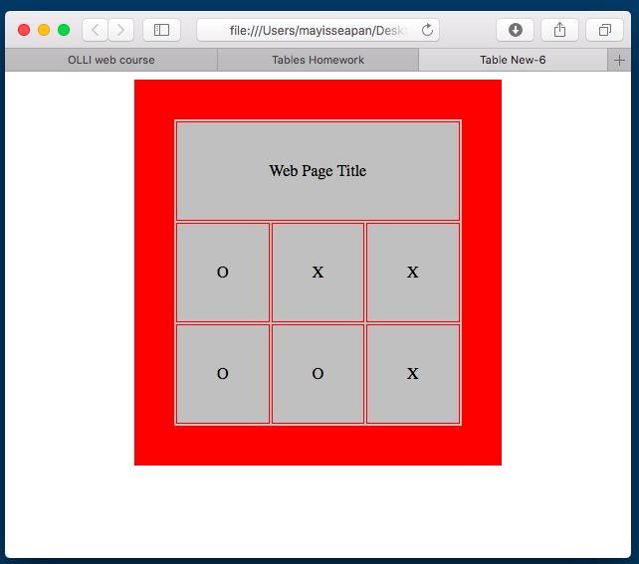
html file
Web
<html> <head> <title>Table 6</title>
</head> <body>
<table align="center" border=”40"
cellpadding="40" bgcolor="silver”
bordercolor="red">
<tr> <td align="center" colspan="3">
Web Page Title</td> </tr>
<tr> <td align="center">O</td>
<td align="center">X</td>
<td align="center">X</td> </tr>
<tr> <td align="center">O</td>
<td align="center">O</td>
<td align="center">X</td> </tr>
</table> </body> </html>

Slide 8
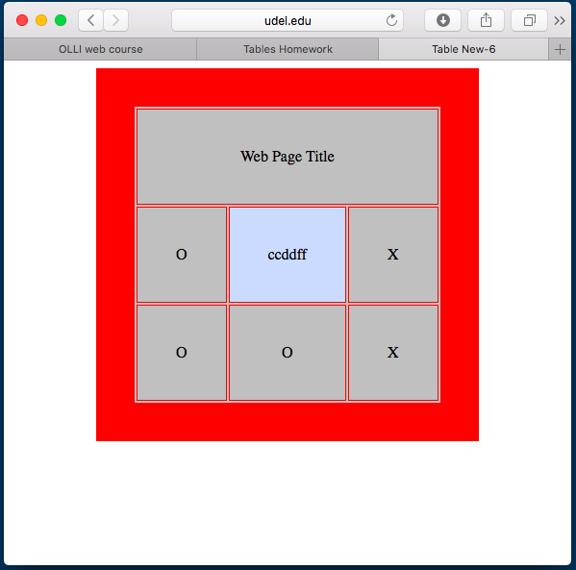
html file
Web
<html> <head> <title>Table 6</title>
</head> <body>
<table align="center" border=”40"
cellpadding="40" bgcolor="silver”
bordercolor="red”>
<tr> <td align="center" colspan="3">
Web Page Title</td> </tr>
<tr> <td align="center">O</td>
<td align="center"
bgcolor="#ccddff">ccddff</td>
<td align="center">X</td> </tr>
<tr> <td align="center">O</td>
<td align="center">O</td>
<td align="center">X</td> </tr>
</table> </body> </html>

Slide 9
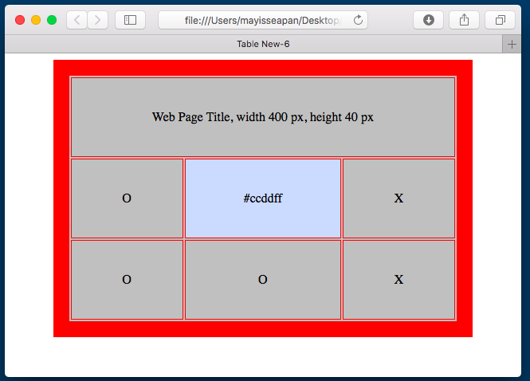
html file
Web
<html> <head> <title>Table 6</title>
</head> <body>
<table align="center" border=”20"
cellpadding="40" bgcolor="silver”
bordercolor="red”>
<tr> <td align="center" colspan="3">
width="400" height="40"> Web Page Title, width 400 px, height 40 px</td>
</tr>
<tr> <td align="center">O</td>
<td align="center"
bgcolor="#ccddff">#ccddff</td>
<td align="center">X</td> </tr>
<tr> <td align="center">O</td>
<td align="center">O</td>
<td align="center">X</td> </tr>
</table> </body> </html>

Slide 10
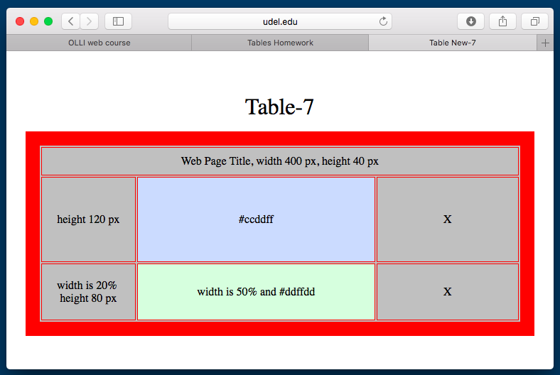
html file
Web
<html> <head> <title>Table 7</title> </head> <body> <br><br> <p align="center"><font size="5"> Table-7</p>
<table align="center" border="20" bgcolor="silver" bordercolor="red">
<tr> <td align="center" colspan="3" width="400" height="40"> Web Page Title, width 400 px, height 40 px</td> </tr>
<tr> <td align="center" height="120">height 120 px</td> <td align="center" bgcolor="#ccddff">#ccddff</td> <td align="center">X</td> </tr>
<tr> <td align="center" width="20%" height="80"> width is 20% <br>height 80 px</td> <td align="center" width="50%" bgcolor="#ddffdd"> width is 50% and #ddffdd</td> <td align="center">X</td> </tr>
</table> </body> </html>

