Slide 1
Why transition planning may be right for you
Nationwide, the Nationwide N and Eagle, Nationwide is on your side and Land As Your Legacy are service marks of Nationwide Mutual Insurance Company. © 2015 Nationwide
Notes:
Most farms today, roughly 97%¹, are family farms. And despite the many perceived advantages of family businesses, it’s estimated that only:
30% of family businesses pass to the second generation²
12% of family businesses pass to the third generation² 3% of family business reach the fourth generation²
Hi. I’m ________________ with _________________ and I’m here today to talk to you about the importance of transition planning for farmers and ranchers.
1. http://www.usda.gov/factbook/chapter3.htm#policy, (03/2011)
2. http://findarticles.com/p/articles/mi_m1TOL/is_9/ai_n25102493/, (03/2011)

Slide 2
Some things you need to know
This presentation was not intended by the author to be used by anybody for the purpose of avoiding any penalties that may be imposed on you pursuant to the Internal Revenue Code. The information contained herein was prepared to support the promotion, marketing and/or sale of life insurance contracts, annuity contracts and/or other products and services provided by Nationwide Life Insurance Company.
Federal tax laws are complex and subject to change. Neither the company nor its representatives give legal or tax advice. Please talk with your attorney or tax advisor for answers to your specific questions.
Investing involves risk, including possible loss of principal
Variable insurance products are underwritten by Nationwide Life Insurance Company, Columbus, Ohio, a subsidiary of Nationwide. The general distributor is Nationwide Investment Services Corporation, member FINRA.
NFM-10575AO.6 (11/15)
APPROVED FOR CLIENT USE
Notes:
But before we get started, there are a few important things you should know.
READ SLIDE

Slide 3
Agenda
Agricultural demographics
Nationwide’s ties to the agricultural community
The need for transition planning
What is Nationwide’s Land As Your Legacy program?
Some common family scenarios
Some things to consider
Next steps
3

Slide 4
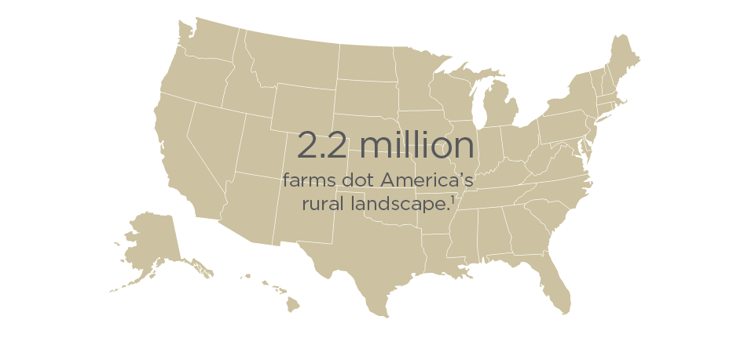
About 97%
of U.S. farms are
operated by familes.²
Only 11%
of family farms have
transition plans in place.¹
70% of U.S.
farm land will transfer to the
next generation over the
next 20 years.
1 Keeping farm in family requires strategy, Larry Copeland, USA TODAY, July, 9 2012.
2 Fast Facts About Agriculture, The Voice of Agriculture®, American Farm Bureau Federation®, fb.org/index.php/index.php?action=newsroom.fastfact
3 2012 Census of Agriculture, Preliminary Report Highlights, agcensus.usda.gov.Publications/2012/Preliminary_Report/Highlights.pdf
4
Notes:
It didn’t take long after reviewing the research and information to come to a pretty quick conclusion on the topic of our focus. We need to assist the farm families in transitioning threw the various transitions ultimately to the next generation.
Here’s what the information shows us. There are 2.2 million farm operations in the United States. 97% of them are family run businesses. You cannot talk about farms in the United States without talking about family. This presentation will contain a strong element about how the family fits into the farm operation and farm transition process.

Slide 5
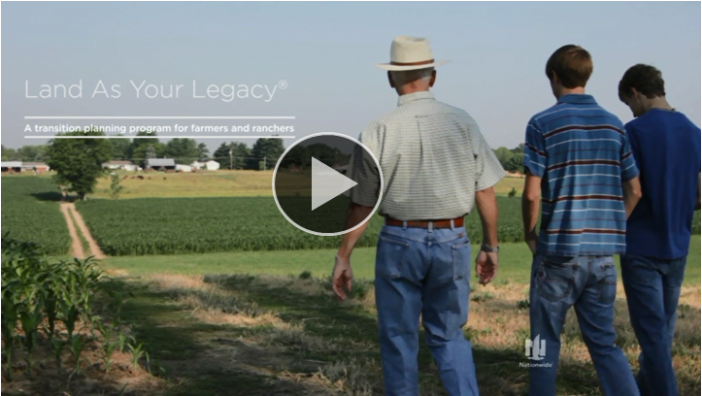
5
Notes:
Let’s take a few minutes and watch a 3 minute video. This clip does a great job of introducing the program to prospects and why Nationwide has created Land As Your Legacy.
(click on image. Takes you to LAYL site on nationwide.com. Play video from there)

Slide 6
Nationwide’s board currently
seats nine active farmers
Tim
Corcoran
Jack
Alphin
Irv
Bell
Ken
Davis
Dan
Kelley
Terry
McClure
Brent
Porteus
Mike
Toelle
Jeff
Zellers
6
Notes:
Why Nationwide?
We have a long-term relationship with the farming community:
9 of Nationwide’s board members are active farmers including our chairman Tim Corcoran.

Slide 7
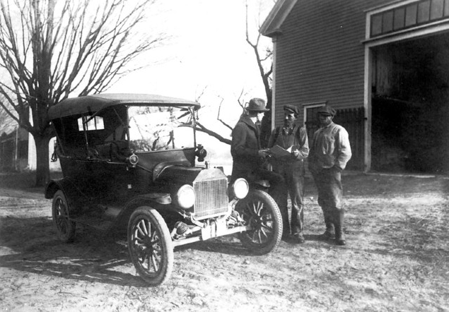
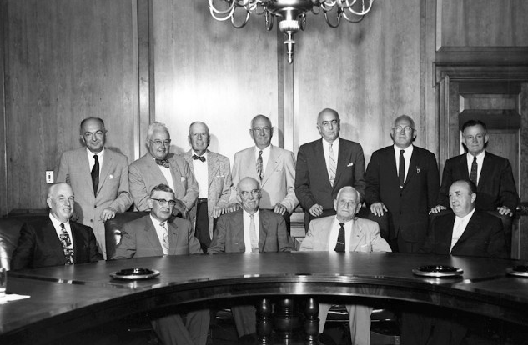
Nationwide’s history is rooted in agriculture
1926
Ohio Farm Bureau leaders launch Farm Bureau Mutual
1955
The name Nationwide was adopted to reflect growth goals
1982
Nationwide acquires Farmland Insurance, now Nationwide Agribusiness Insurance, a 100-year-old company and America’s leading farm insurer.
2011
Land As Your Legacy is launched to support succession planning amongst farmers and ranchers
Today
Nationwide Agribusiness is America’s #1 farm insurer. Nationwide is a Fortune 100 company* and supported by nine state farm bureaus and two regional farm cooperatives
*For fiscal year ending on 1/31/15
7
Notes:
In 1926, Ohio Farm Bureau leaders launched Farm Bureau Mutual with $10,000 of borrowed capital and a promise to serve members with high quality, affordable insurance.
In 1955, the name of Nationwide was adopted to reflect growth goals, but the original promise has remained – along with our commitment to serve people in agriculture.
In 1982 Nationwide acquired Farmland Insurance and that is now Nationwide Agribusiness, the country’s leading farm insurer.
In 2011 Land As Your Legacy was launched to support farmers and ranchers when transitioning their operation to the next generation.
Today, Nationwide Agribusiness is America’s number-one farm insurer, supported by a network of Nationwide and Independent Insurance Agents serving customers coast-to-coast.
Nationwide is also supported by nine Farm Bureaus and two regional farm cooperatives that sponsor and endorse the company.

Slide 8
Nationwide Impact
$345 million
Through its foundation, since 2000,
Nationwide has awarded more than $345
million to help communities around the
country. A significant part of that support goes to worthy agricultural organizations such as FFA, 4-H, Farm Safety 4 Just Kids, the American Farm Bureau Foundation and the National Council of Farmer Cooperatives Foundation, as well as our national partners: Feeding America, Nationwide Children’s Hospital, United Way and the American Red Cross.
8
Notes:
Read slide

Slide 9
Who has a transition plan?
Everyone has a transition plan in place.
The state you live in has enacted laws governing most aspects of estate planning and probate, lack of creating your own plan allows your state laws to determine how your legacy will be carried out.
What plan do you want? The plan your state created or your own plan?
9

Slide 10
Need for farm and ranch
transition planning
Transition planning can help with:
Preserving a legacy
Safeguarding the value in an operation
Setting up an orderly transition of ownership
Providing education on financial basics
Turning non-liquid assets into cash to cover taxes and expenses
Identifying and managing risks
10

Slide 11
5 key phases of
Land As Your Legacy
1
Succession planning – Creating the path to successfully pass the
business to the next generation
2
Business planning – Ensuring profitability now and in the future
3
Risk management – Identifying and preparing for risks to the operation
4
Financial independence – Creating financial independence from the
farm so that the next generation can start
taking income from the operation, while the
senior operator keeps serving as a mentor
5
Estate planning – Getting the documents in place to create an orderly
distribution of assets upon death and settle any
liabilities due at that time in a manner consistent with
the wishes of the deceased
11

Slide 12
Step 1:
Fact gathering
Step 2:
Plan development
What is it?
Will involve one or more meetings to uncover the objectives necessary to develop a transition plan
What is it?
Nationwide’s process to design a suggested transition plan tailored to your specific needs and objectives
Who’s involved?
People key to the farming operation, your Land As Your Legacy advisor
Who’s involved?
People key to the farming operation, your Land As Your Legacy advisor with support from Nationwide
Step 3:
Implement plan
Step 4:
Annual Review
What is it?
The family deciding on a course of action and taking the necessary steps to ensure a proper transition of the farm when necessary
What is it?
The family meets on an annual basis to discuss any changes that may have taken place or will be taking place that could alter the existing plan
Who’s involved?
People key to the farming operation, your Land As Your Legacy advisor and possibly legal and tax professionals
Who’s involved?
People key to the farming operation, your Land As Your Legacy advisor
12

Slide 13
Common family scenarios
Active Farming Children
Can the operation support multiple families in the next generation? Does everyone know their role?
Non-Active Farming Children
Is there a role for a non-active child? Concept of Fair vs. Equal
Active Farming Family
Is there a brother or sister you farm with today? What are their plans?
Non-Family Members
Is there a key person or property that the operation needs to retain? Are there ex-family members that could affect the operation?
13

Slide 14
Some things to consider
Older generation’s resistance to retire or desire to maintain control after retirement
Failure to identify succession leadership and mentor next generation leaders
Sibling frictions: estate equalization and fractured ownership
Lack of money to pay for succession planning and support
Fear of crippling financial effects of final illnesses and estate clearance costs
14

Slide 15
The next steps
Complete your evaluation
Schedule a meeting with your Land As Your Legacy advisor
Start thinking and get organized
Transition planning checklist
Document checklist
15
Notes:
Next steps
If you want to give yourself a chance to reach your goals and objectives, you should consider starting right now. This is not about preparing for some distant time in the future. This is about how you’re going to live and operate your business tomorrow and every day thereafter, so that your objectives are accomplished.
Deciding to begin, is the very first step. Generally, a farmer’s success is based on doing what a farmer does to be successful. A key idea is to get a person in who’s job is to be the transition planning quarterback, and from there put the rest of the members of the team together based on your needs and objectives.
Nationwide also offers tools to help you evaluate your personal situation.

Slide 16
Thank you
NFM-10575AO.6 (11/15)
APPROVED FOR CLIENT USE
Notes:
Thank you for your time today and if you have any questions or would like to schedule some time to talk, just give me a call.
(Put in presenter and contact information).

